Slide 1
User Git Analyzer

Slide 2
Module 1: User Github Profile Analyzer
Module 2: Repository Security Scanner

Slide 3
Keywords
GitHub
Repository Security Scanner
User Profiler Analyzer
Static Code Analysis
Machine Learning
React Js
Flask
Data Visualization
Collaboration Enhancement

Slide 4
Table of contents_
01
03
02
04
Introduction
Project Design
Literature Survey
Conclusion

Slide 5
Introduction_
1.1 Overview
In today's software development landscape, GitHub has become the epi-centre of collaborative coding. It's the go-to platform for hosting open-source projects and collaborating with developers worldwide. However, this widespread adoption has also brought about significant security and quality challenges.

Slide 6
Introduction_
1.1.1 Github User Profile Analyzer
The GitHub User Profiler is a web-based platform that leverages a combination of advanced technologies to offer an in-depth analysis of GitHub user profiles and repositories. Developed with a user-centric approach, its frontend is built using React, ensuring a userfriendly and responsive interface. The backend integrates Python-based machine learning User Git Analyzer and real-time API requests, granting the platform scalability and reliability. Machine learning algorithms are employed to cluster users based on key parameters such as Stars Count, Issue Count, Forks Count, Number of Contributions, and Pull Requests.

Slide 7
Features
1.1.1 Github User Profile Analyzer
Visualization Capabilities - PieCharts , Donuts and more…
Language Breakdown – Repos per language
Commit Distribution - Commits per repo
Star Highlights – Stars per repo
Collaboration And Hiring

Slide 8
Introduction_
1.1.2 Github Security Scanner Tool
The GitHub Security Scanner is a repository scanning tool designed to bolster the security of GitHub repositories. It combines state-of-the-art technologies to provide a robust solution for identifying and addressing security vulnerabilities within code repositories. With an emphasis on usability and efficiency, this tool equips developers and organizations with the means to enhance the integrity of their codebases, ultimately fostering a more secure development ecosystem on GitHub.

Slide 9
Features
1.1.2 Github Security Scanner Tool
Static Code Analysis: The GitHub Security Scanner leverages advanced static code analysis, including SAST (Static Application Security Testing) and SCA (Software Composition Analysis) techniques. This comprehensive examination ensures that GitHub repositories are thoroughly scrutinized for security vulnerabilities, misconfigurations, and potential threats.
User-Friendly Interface: Built with React, the tool offers an intuitive and responsive user interface, facilitating user interactions and making it effortless to access vital security insights. This user-centric design streamlines the process of identifying and resolving security issues, making it accessible to developers with varying levels of expertise.

Slide 10
1.2 Objectives
To develop a user-friendly web-based platform that provides a comprehensive report of a candidate's GitHub profile, including real-time analysis, intuitive visualizations, and continuous monitoring.
To help technical leads identify efficient candidates for projects by providing them with information about the candidate's contributions to open-source projects, their coding style, and their familiarity with different programming languages and technologies.
To develop a GitHub security scanner that identifies security vulnerabilities in GitHub repositories.
To help developers improve the security of their code and protect their applications from attacks

Slide 11
1.3 Motivation
HR recruitment: The GitHub profiler will help technical leads identify efficient candidates for projects by providing them with a comprehensive report of the candidate's GitHub profile. This report will include information such as the candidate's contributions to open-source projects, their coding style, and their familiarity with different programming languages and technologies.
Security: The GitHub security scanner will help developers identify security vulnerabilities in their code. This will help them to improve the security of their code and protect their applications from attacks.

Slide 12
2 Literature Survey
Research Paper | Conference | Author | Description
Vritthi – a theoretical Framework for IT recruitment based on machine learning Techniques applied over Twitter, LinkedIn, SPOJ and GitHub Profiles | 2016 International Data Conference Mining and Advance computing | A. Giri, A.Ravikumar, S. Mote and R. Bharadwaj | The paper presents Vritthi, aninnovative recruitment system leveraging social networks like Twitter and LinkedIn, code repositories like GitHub, and competitive coding platforms to automatically match jobseekers withjob requirements using data mining and machine learning.
Data collection and analysis of GitHub repositories and users | 2015 6th International Conference on Information, Intelligence, Systems and Applications (IISA) | Fragkiskos Chatziasimidis, Ioannis Stamelos | Using GitHub API, data from around 100K projects and 10K users/owners were collected. Statistical analysis, k-means discretization, and apriori algorithm in Weka (Data mining and ML tool) were applied to identify association Rules

Slide 13
2 Literature Survey Cont..
Research Paper | Conference | Author | Description
DevFlair: A Framework to Automate the Prescreening Process of Software Engineering Job Candidates | 022 4th International Conference on Advancements in Computing (ICAC) | R.Jayasekara, K. A.N.D. KudaRachchi, K.G.S.S.K. Kariyawasam, D. Rajapaksha, S.L.Jayasinghe, S.Thelijjagoda | Devflair framework: DevFlair uses data from social media, GitHub, and open-ended questionnaires to predict the Big-Five personality traits, analyze technical skill expertise, and analyze the experience in using industry-related online platforms
Anomalicious: Automated Detection of Anomalous And Potentially Malicious Commits on GitHub | 2021 IEEE/ACM 43rd International Conference on Software Engineering | D.Gonzalez, T.Zimmermann , P.Godefroid M. Schaefer | Anomalicious is an automated tool that uses commit logs and repository metadata to identify potentiallymalicious contributions in opensource software (OSS) repositories. It showed promising results by detecting 53.33% of malicious commits while flagging less than 1% of commits in most repositories.

Slide 14
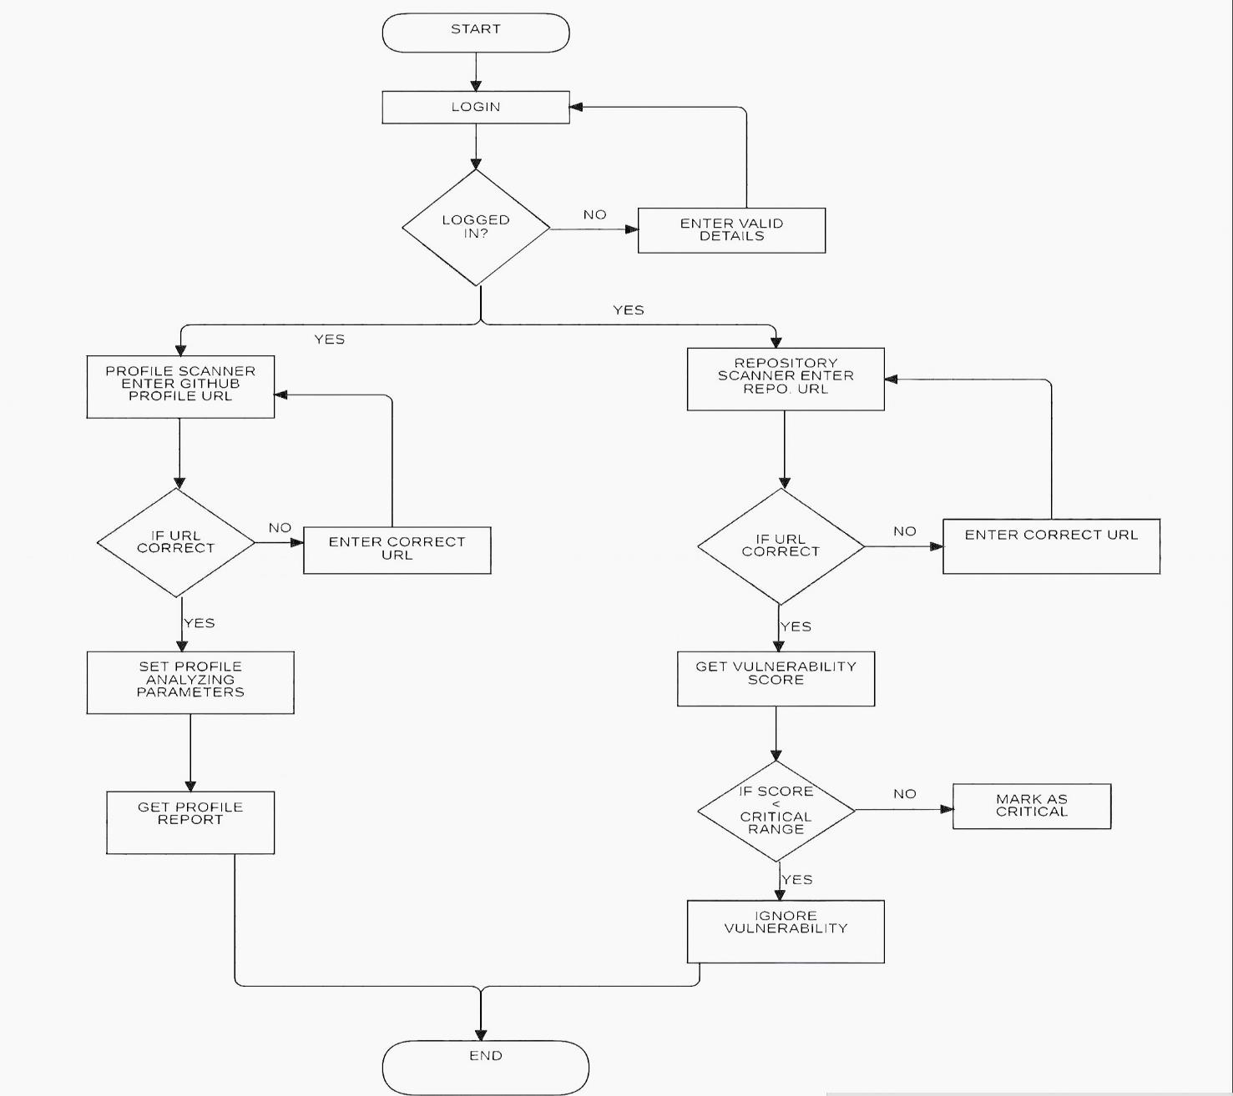
3 Project Design
Flowchart :

Slide 15
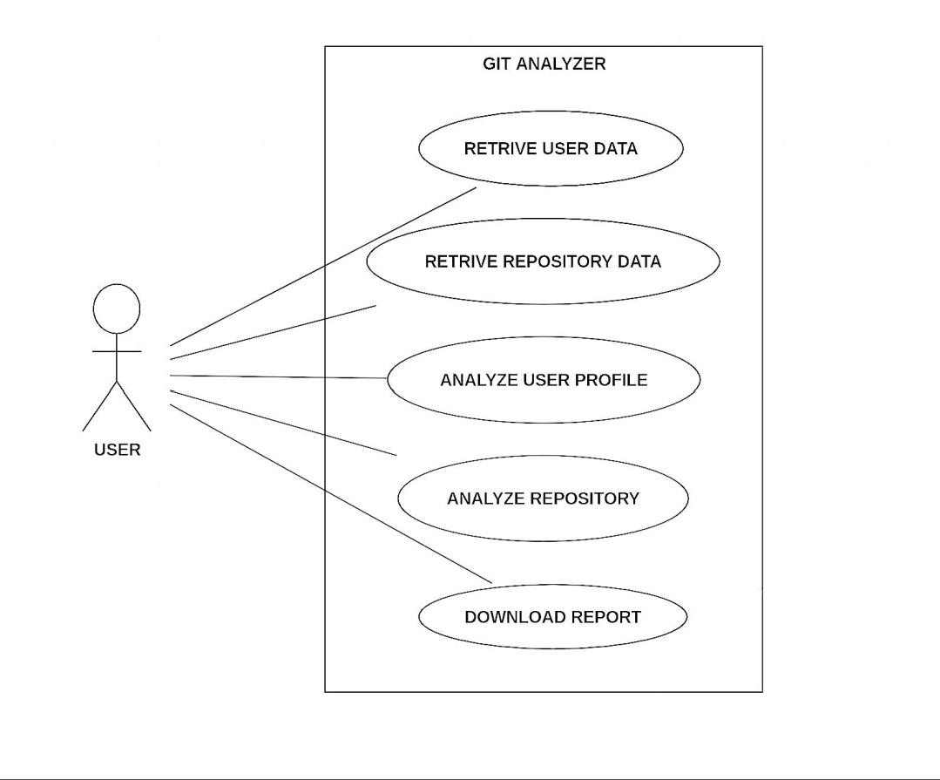
3 Project Design
Use Case :

Slide 16
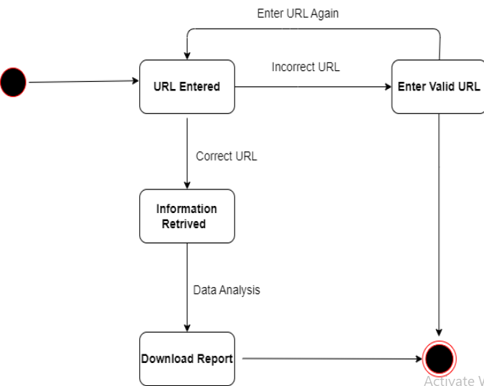
3 Project Design
State Diagram:
Profile Analyzer

Slide 17
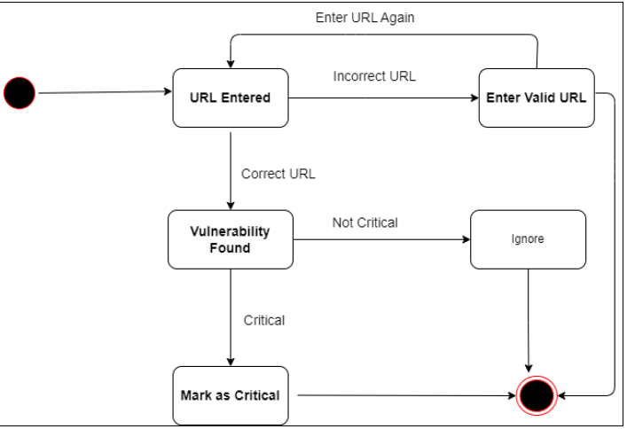
3 Project Design
State Diagram:
Repository
Analysis

Slide 18
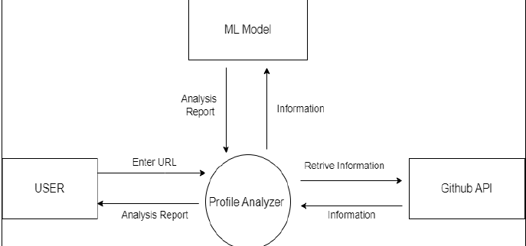
3 Project Design
Data flow :

Slide 19
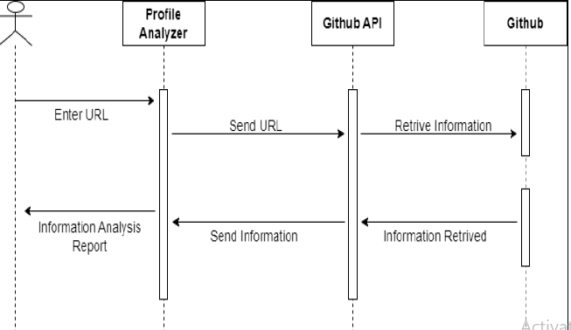
3 Project Design
Sequence Diagram:

Slide 20
Project Plan
Phase 1: Data Gathering and Preparation
Phase 2: System Design - Partition the project into two phases: User Profile Analyzer and Security Scanner.
Phase 3: User Profile Analyzer - Create a generalized logistics of data flow for the User Profile Analyzer. Analyze which parameters are important for analysing a user profile on GitHub.
Phase 4: Security Scanner - Create a logistics to make the tool and the dataflow for the analysis of the codebases. Analyze the method which will be used for making the tool.
Phase 5: Technology Usage Identify the technologies that will be used for the project.
Phase 6: Development of Phase 1 (Frontend)
Phase 7: Development of Phase 1 (Backend)
Phase 8: Development of Phase 2 (Frontend)
Phase 9: Development of Phase 2 (Backend)
Phase 10: Deployment

Slide 21
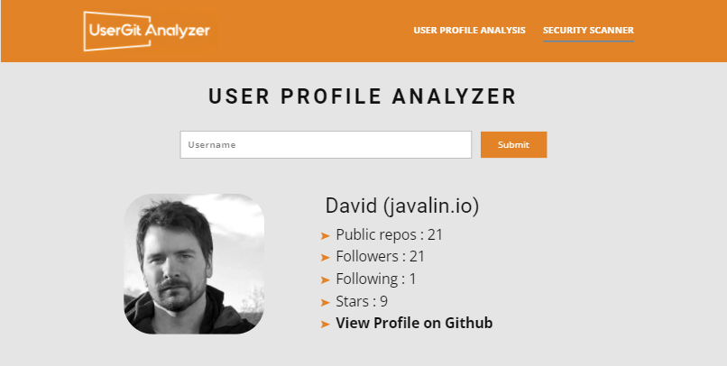
Project Prototype

Slide 22
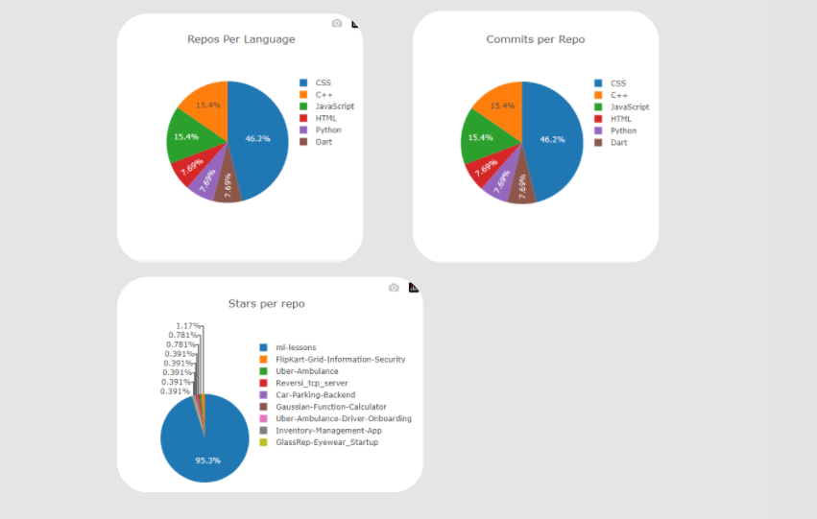
Project Prototype

Slide 23
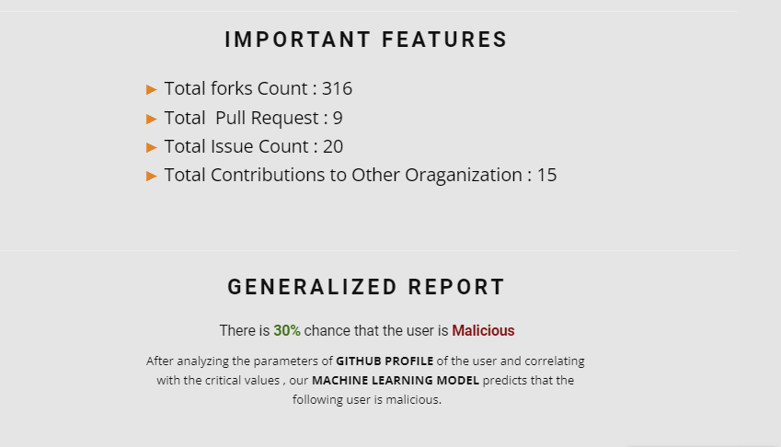
Project Prototype

Slide 24
Conclusion
The "GitHub Profile and Repository Analyzer" project represents a pivotal step forward in addressing the evolving needs of the software development and open-source community. This meticulously designed web-based platform integrates advanced technologies like React, Flask, and Python for machine learning to deliver a scalable, secure, and user-centric solution. By incorporating static code analysis and machine learning, it empowers users to enhance code security, streamline collaboration, and make informed decisions about project contributors.

